Slide 1
Vaccines, Variants, IHME model
Table 3. The SEIR model uses variant-specific estimates of vaccine efficacy at preventing symptomatic disease and at preventing infection. We use data from clinical trials directly, where available, and make estimates otherwise. More information can be found on our website (http://www.healthdata.org/node/8584).
IHME. COVID-19 Results Briefing. Iran (Islamic Republic of). May 21, 2021
https://www.healthdata.org/sites/default/files/covid_briefs/142_briefing_Iran_Islamic_Republic_of.pdf
This file May 23, 2021

Slide 2
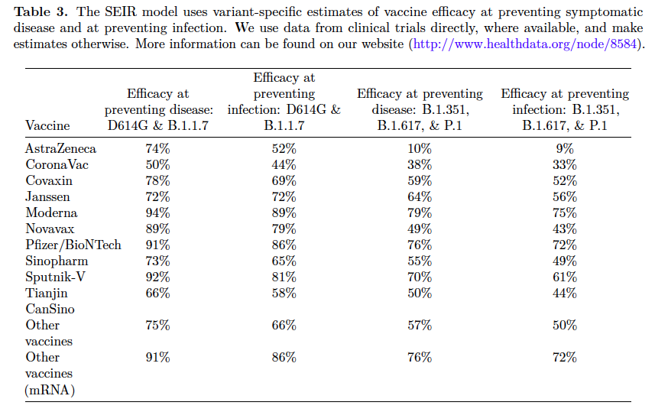

Slide 3
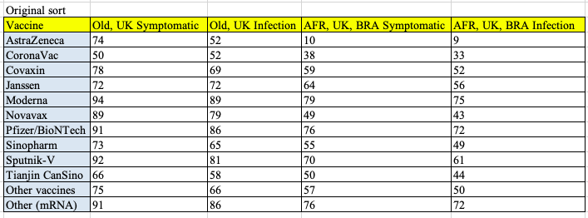
> > >
>
>

Slide 4
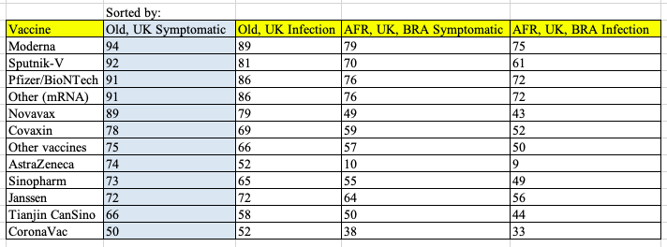

Slide 5
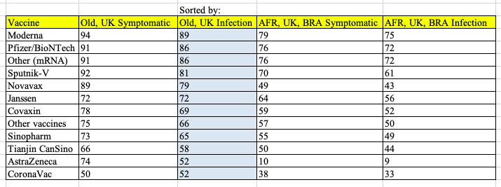

Slide 6
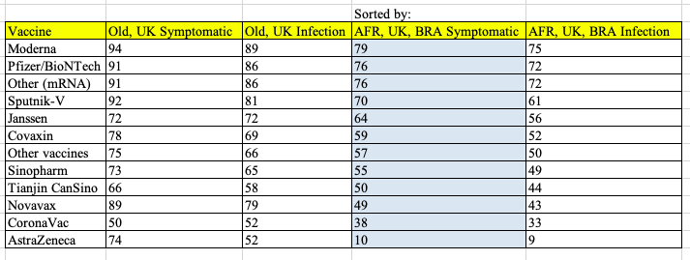

Slide 7
